Slide 1

Industry Project Presentation on Website development (Front-end) Using React JS
By
Tanishk Patel (20162121020)
Institute of Computer Technology, Ganpat University
Date: 12th May 2024

Slide 2
Table of Contents
Introduction
Objectives
Related Background
Expected Outcome
Tools & Technology
Methodology (Modules)
Design / Diagrams & TimeLine Charts with Milestones
Flowcharts
Implementation Details
Conclusion
References

Slide 3
Introduction
In our work we are building a Web Page using React JS, This project report provides a concise overview of the frontend development process using React JS, a leading JavaScript library for building user interfaces. It outlines the project's objectives, scope, and rationale for choosing React JS.Our goal is to create a interactive and responsive web page for better user experience.

Slide 4
Objectives
Develop a dynamic and interactive user interface using React JS to enhance user experience.
Implement reusable UI components to improve code maintainability and scalability.
Integrate React JS with external APIs for data fetching and updating content dynamically.
Ensure responsiveness and cross-browser compatibility for seamless user interaction across devices.
Optimize frontend performance to minimize load times and improve overall user experience.
Collaborate effectively with backend developers to integrate frontend components with the server-side logic.
Deliver a polished and feature-rich frontend application that meets the project requirements and exceeds user expectations.

Slide 5
Expected Outcome
We expect user-friendly web application interface built with React JS. It seamlessly integrates with external APIs for real-time data updates, ensuring high responsiveness and cross-browser compatibility.Comprehensive testing ensures reliability, while effective collaboration between frontend and backend developers results in seamless integration. Overall, the outcome is a feature-rich frontend application that meets project requirements and user expectations

Slide 6
Tools and Technologies
Tools :
Visual Studio
Technologies:
React Js
Css
HTML

Slide 7
Methodologies (Modules)
The methodology for the project using React JS involves several key steps to ensure the successful development of the frontend application. Firstly, thorough requirement analysis is conducted to understand project goals, user needs, and functional requirements. Following this, the design phase involves planning UI/UX wireframes and component hierarchy to create a cohesive and intuitive user interface. In the development phase, React JS is utilized to implement UI components, state management, routing, and integration with external APIs. Testing is then carried out comprehensively, encompassing unit tests, integration tests, and end-to-end tests to validate functionality and reliability. Optimization efforts focus on refining the codebase, improving performance, and ensuring responsiveness for an enhanced user experience. Collaboration with backend developers is essential for seamless integration and data flow between the frontend and backend systems.

Slide 8

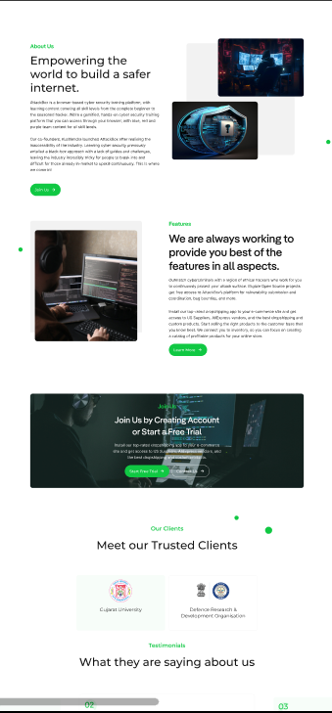
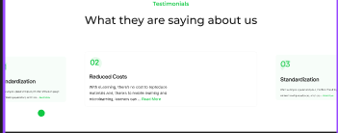
Design / Diagrams & TimeLine Charts with Milestones

Slide 9
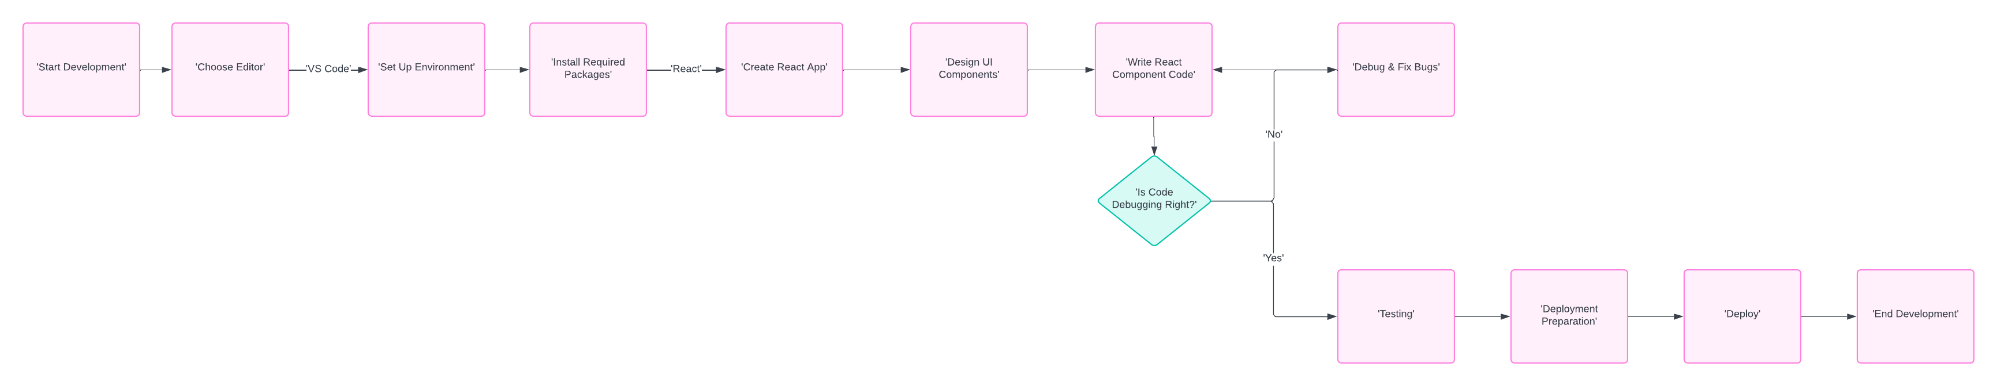
Flowcharts
https://lucid.app/lucidchart/6bb1dd2a-a55f-480e-9bdc-7c6888ff1f24/edit?viewport_loc=-1449%2C-2090%2C3975%2C1407%2C0_0&invitationId=inv_1f97b0fe-7e10-469e-b29e-c699dd62f502

Slide 10
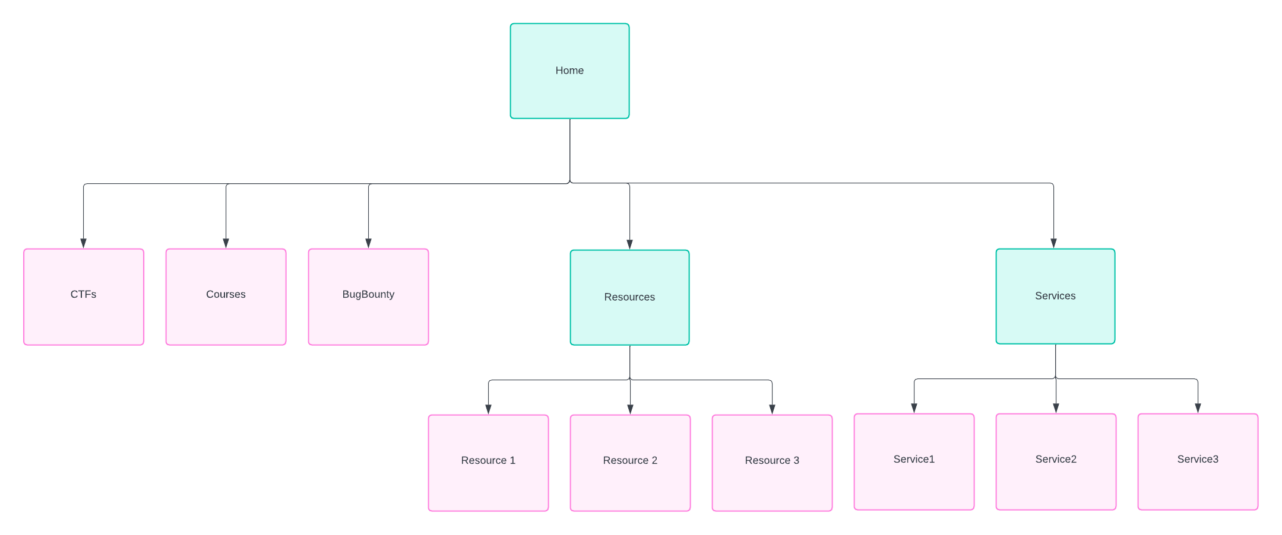
Flowcharts

Slide 11
Implementation Details

Slide 12
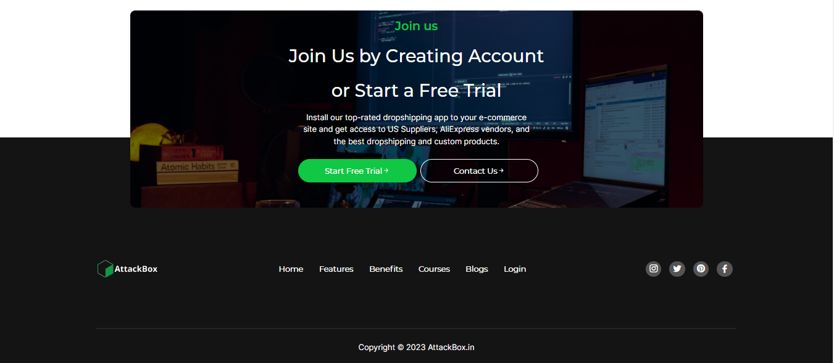
Implementation Details

Slide 13

Implementation Details

Slide 14

Implementation Details

Slide 15

Implementation Details

Slide 16
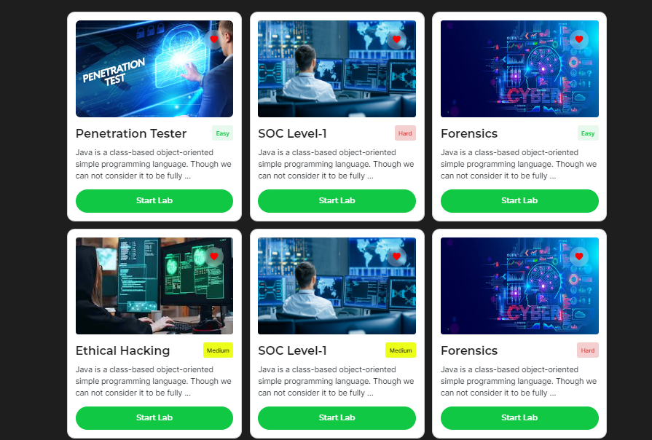
Implementation Details

Slide 17
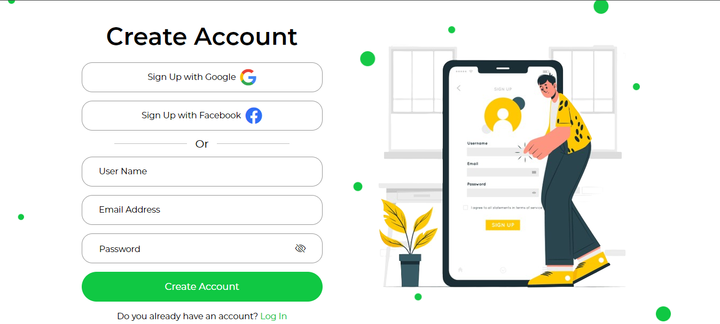
Implementation Details

Slide 18

Implementation Details

Slide 19
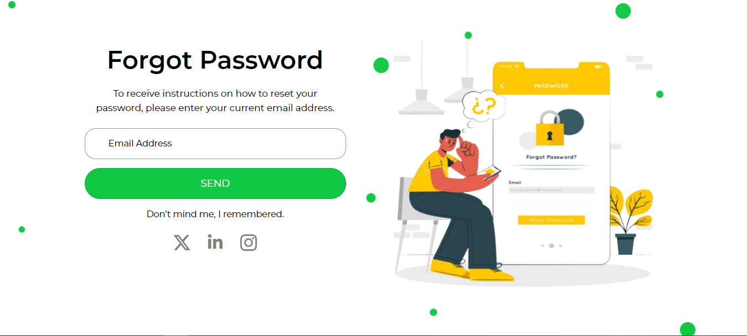
Implementation Details

Slide 20

Implementation Details

Slide 21

Implementation Details

Slide 22
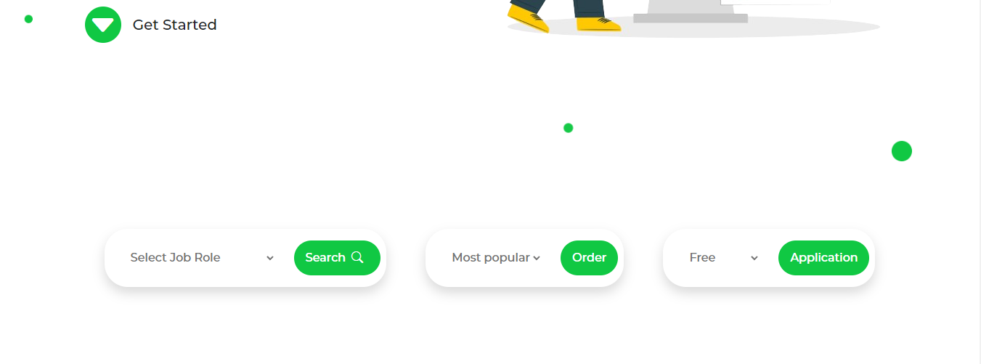
Implementation Details

Slide 23
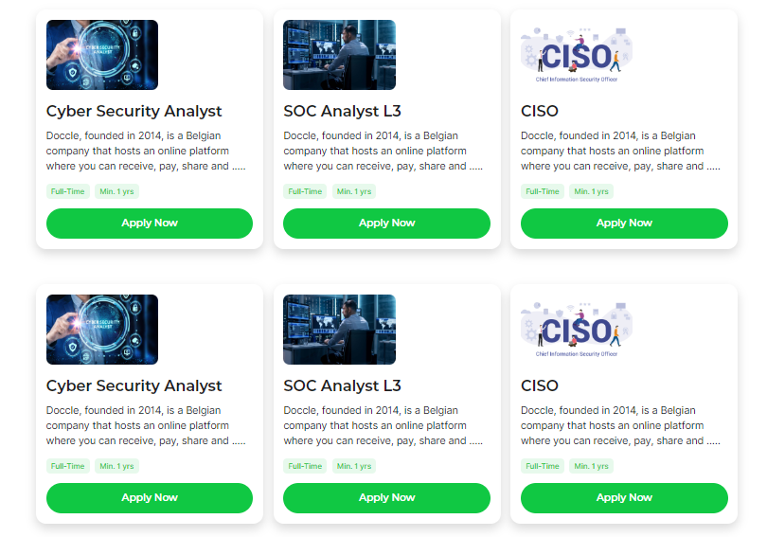
Implementation Details

Slide 24
References
https://getbootstrap.com/
https://www.w3schools.com/
https://icons.getbootstrap.com/
https://fontawesome.com/

Slide 25
Thank You !!

